Slide 1
Venue Based Clustering using Foursquare API
Coursera Capstone Project
Nishant Zope [May 2020]

Slide 2
Introduction
Cities which are different geographically, economically and culturally can still hold some similarities based on the venues or amenities they offer. This type of characterization of cities could be named as Venue-Based similarity¹.
While several researches comparing cities based on economic and geographic aspects between cities have been extremely useful, a venue-based similarity clustering is relatively less explored. Utilizing the similarity of venues between cities could be helpful for people in making critical decisions.
Problem Statement
We aim to find similarity between cities based on the venues and amenities it offers.
Target Audience
People who are looking to move to a different city or planning to buy or rent a property in another city in the United States

Slide 3
Data Requirements
To solve this problem, we used 2 different datasets for this analysis:
Dataset with geographical coordinates of all the capital cities in the United States.
Dataset with top 100 venues within 10-miles of radius of each city obtained using Foursquare API.
Data Sources:
STATES directory [made available by John Burkardt from The Department of Scientific Computing at Florida State University]², which contains datasets with information on U.S states.

Slide 4
Methodology
Data Collection
The US city data was collected by manually downloading the 2 files state_capitals_ll and state_name in csv format.
Venue data was obtained using the explore function of Foursquare API, which was received in json format which was converted to pandas dataframe.
Data Preprocessing and Cleaning
The 2 files state_capitals_ll and state_name were joined using State as the key to create one dataframe named df which becomes the base dataset for our analysis.
The venue dataset obtained from Foursquare.com was grouped by City and venue categories were one-hot-encoded to convert categorical Venue Category column into numeric columns.
Since, the dataset was obtained in structured format and had no missing or incorrect values, minimal cleaning efforts were needed

Slide 5
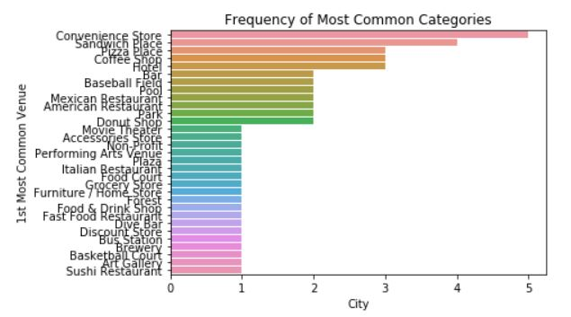
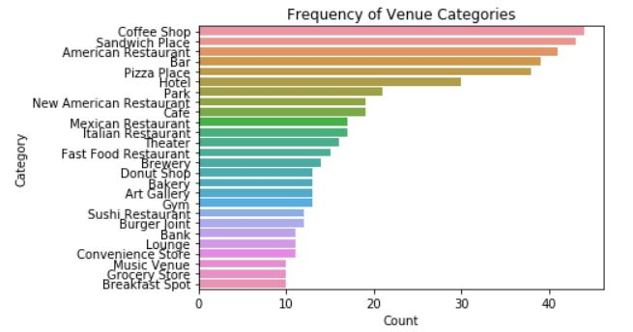
Results (Exploratory Analysis)
Below plot shows that Food related venues like Coffee Shops, Restaurant and Sandwich places are more common in these cities.
The categorization of the venues is not accurate for this clustering approach as there are various categories which fall under one category. For example, American Restaurant and New American Restaurants must be included in one category – Restaurant
Below plot shows that most of the capital cities in the US have Convenience Store and Eateries like Sandwich place, coffee shops and pizza places.

Slide 6
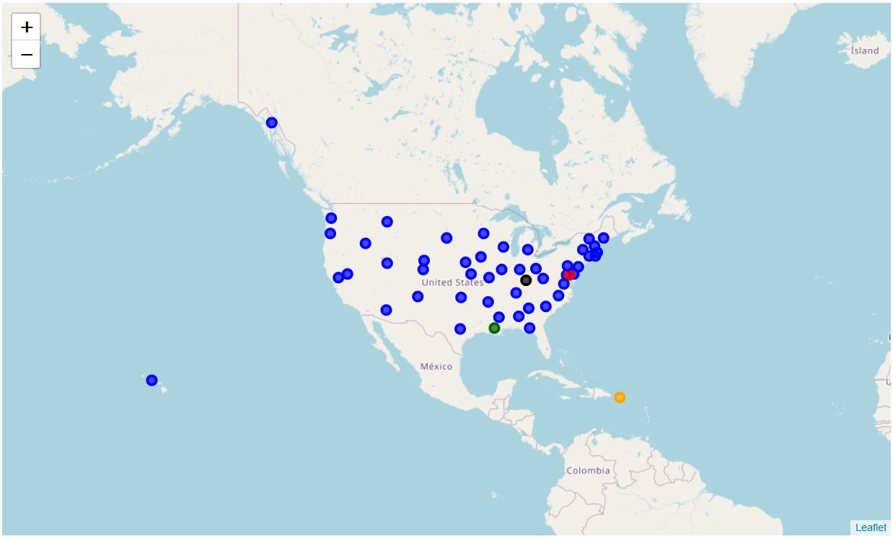
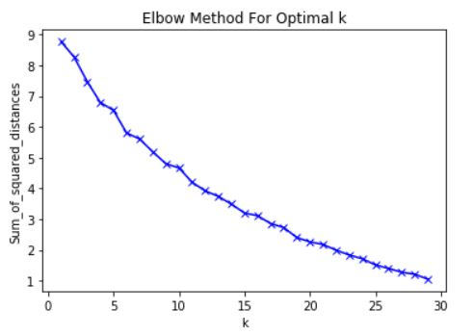
Results (Modeling)
Below are the clusters obtained with K = 5
K = 5 (number of clusters = 5) seems incorrect choice as one cluster contains 99% of the data points.
To find the optimal number of clusters for this problem, we used Elbow method to determine the value of K, which was obtained by comparing the error for each value of K from 1 to 25.
Increasing K was not the only solution we had to make sure that the clustering is justified with the K selected. For example, selecting K greater than 20 would mean that in best case most of the clusters would contain 2 or 3 cities and in worst case most of the clusters would be empty of would contain only one city.
Hence, we selected K = 10 as there is elbow at this value and these many number of clusters seems justifiable

Slide 7
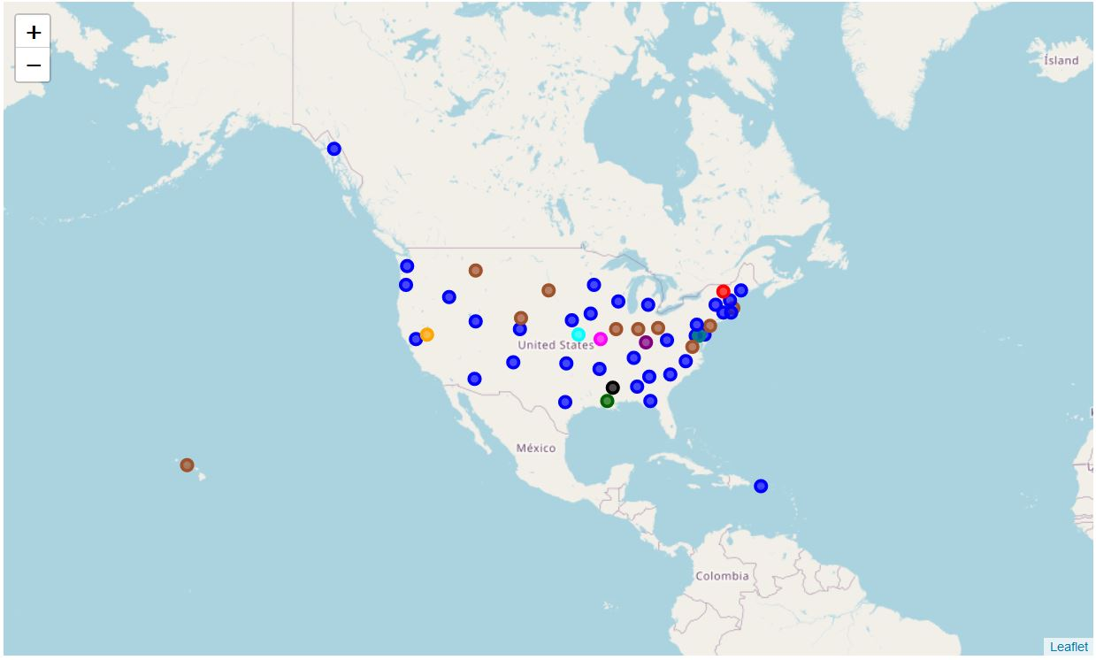
Results (Modeling)
Below are the clusters obtained with K = 10
Clusters obtained using K = 10 which looks far better than previous clustering.
We also found similarities in the cities that lie in the same clusters.

Slide 8
Discussion
Observations
Cluster 1 and cluster 6 has cities that look similar when we compare the venues which shows that the approach though is naive still results in clusters with similar data points or cities. For example, Cluster 1 which has cities like Albany, Denver and Atlanta have Restaurants as most common venues, while Cluster 6 consists of cities like Helena and Columbus where Parks are the most common venues.
However, only these 2 clusters consist multiple data points or cities and rest of the clusters a formed with only one city.
Further improvements
Above observations imply that this clustering approach is not enough for determining venue-based similarities between cities. There could be multiple reasons behind this. Some of them are:
The Venue Categories obtained from Foursquare database are overlapping which makes it difficult for clustering algorithm to find similar cluster points. For instance, there are sub-classes of restaurants like Mexican Restaurant and American Restaurant which must be combined into one single category of Restaurants, because the choice of restaurant would vary person to person in the city.
More sophisticated algorithms could be used like Density based Clustering to create more accurate clustering.
More data could be used for such complex analysis as the current analysis is only based on top 100 venues within 10 miles of radius. Increasing venues and radius might also impact the efficacy of this clustering algorithm.

Slide 9
Conclusion
This approach of venue-based clustering seems a good way of finding similarities between different cities across the United States
However, this approach needs more granular and refined datasets along with more sophisticated algorithms to provide accurate clustering results.

Slide 10
Appendix & References
References
https://www.sas.upenn.edu/~danielpr/files/cities13urbcomp.pdf
https://people.sc.fsu.edu/~jburkardt/datasets/states/states.html

